Slide 1

CHAPTER 4
ELEMENTARY NUMBER THEORY AND METHODS OF PROOF
Copyright © Cengage Learning. All rights reserved.

Slide 2

4.6
Direct Proof and Counterexample Ⅵ: Floor and Ceiling
Copyright © Cengage Learning. All rights reserved.

Slide 3
Direct Proof and Counterexample Ⅵ: Floor and Ceiling
Imagine a real number sitting on a number line. The floor and ceiling of the number are the integers to the immediate left and to the immediate right of the number (unless the number is an integer, in which case its floor and ceiling both equal the number itself).
Many computer languages have built-in functions that compute floor and ceiling automatically. These functions are very convenient to use when writing certain kinds of computer programs. In addition, the concepts of floor and ceiling are important in analyzing the efficiency of many computer algorithms.

Slide 4
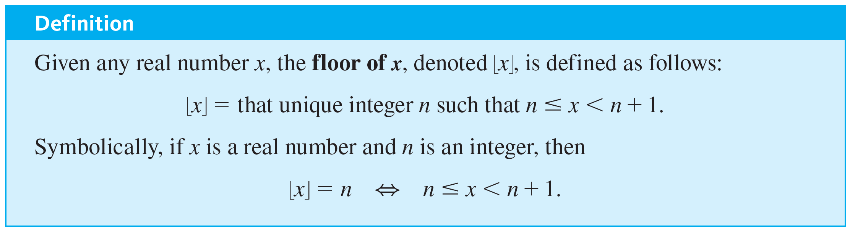
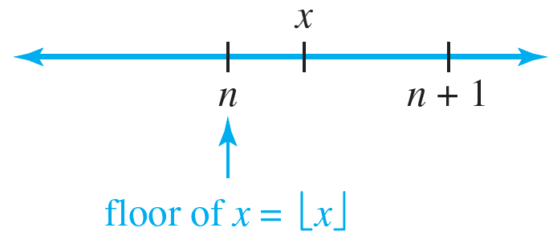
Direct Proof and Counterexample Ⅵ: Floor and Ceiling

Slide 5
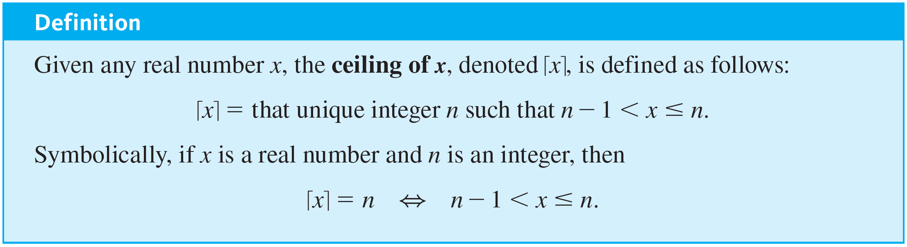
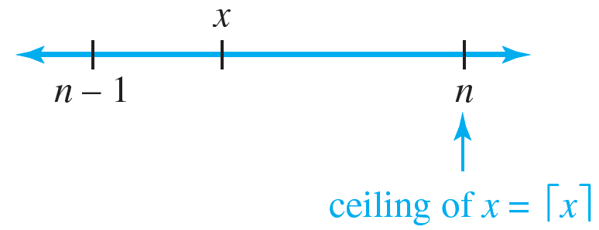
Direct Proof and Counterexample Ⅵ: Floor and Ceiling

Slide 6
Example 4.6.1 – Computing Floors and Ceilings
Compute ⌊x⌋ and ⌈x⌉ for each of the following values of x:
a. 25 ∕ 4 b. 0.999 c. −2.01
Note On some calculators ⌊x⌋ is denoted INT (x).

Slide 7
Example 4.6.1 – Solution
a. 25 ∕ 4 = 6.25 and 6 < 6.25 < 7; hence ⌊25 ∕ 4⌋ = 6 and ⌈25 ∕ 4⌉ = 7.
b. 0 < 0.999 < 1; hence ⌊0.999⌋ = 0 and ⌈0.999⌉ = 1.
c. −3 < −2.01 < −2; hence ⌊−2.01⌋ = −3 and
⌈−2.01⌉ = − 2.

Slide 8
Example 4.6.2 – An Application
The 1,370 students at a college are given the opportunity to take buses to an out-of-town event. Each bus holds a maximum of 40 passengers.
a. For reasons of economy, the leader of the event will send only full buses. What is the maximum number of buses the event leader will send?
b. If the event leader is willing to send one partially filled bus, how many buses will be needed to allow all the students to take the trip?

Slide 9
Example 4.6.2 – Solution
a. ⌊1370 ∕ 40⌋ = ⌊34.25⌋ = 34
b. ⌈1370 ∕ 40⌉ = ⌈34.25⌉ = 35

Slide 10
Example 4.6.4 – Disproving an Alleged Property of Floor
Is the following statement true or false?
For all real numbers x and y, ⌊x + y⌋ = ⌊x⌋ + ⌊y⌋.

Slide 11

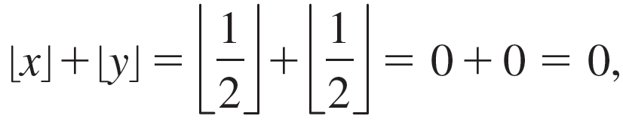
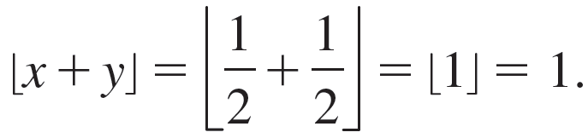
Example 4.6.4 – Solution
The statement is false. As a counterexample, take
Then
whereas
Hence it is not always the case that ⌊x + y⌋ ≠ ⌊x⌋ + ⌊y⌋.

Slide 12
Example 4.6.4 – Solution
continued
To arrive at this counterexample, you could have reasoned as follows: Suppose x and y are real numbers.
Must it necessarily be the case that ⌊x + y⌋ = ⌊x⌋ + ⌊y⌋, or could x and y be such that ⌊x + y⌋ ≠ ⌊x⌋ + ⌊y⌋?
Imagine values that the various quantities could take.

Slide 13
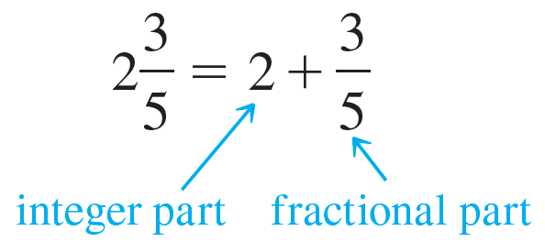
Example 4.6.4 – Solution
continued
For instance, if both x and y are positive, then ⌊x⌋ and ⌊y⌋ are the integer parts of ⌊x⌋ and ⌊y⌋ respectively; just as
so is x = ⌊x⌋ + fractional part of x
and y = ⌊y⌋ + fractional part of y,
where the term fractional part is understood here to mean the part of the number to the right of the decimal point when the number is written in decimal notation.

Slide 14

Example 4.6.4 – Solution
continued
Thus if x and y are positive,
x + y = ⌊x⌋ + ⌊y⌋ + the sum of the fractional parts of x and y.
But also
x + y = ⌊x + y⌋ + the fractional part of (x + y).
These equations show that if there exist numbers x and y such that the sum of the fractional parts of x and y is at least 1, then a counterexample can be found. As previously indicated, there do exist such x and y; for instance,

Slide 15
Example 4.6.5 – Proving a Property of Floor
Prove that for every real number x and for every integer m, ⌊x + m⌋ = ⌊x⌋ + m.

Slide 16
Example 4.6.5 – Solution
Begin by supposing that x is a particular but arbitrarily chosen real number and that m is a particular but arbitrarily chosen integer.
You must show that ⌊x + m⌋ = ⌊x⌋ + m. Since this is an equation involving ⌊x⌋ and ⌊x + m⌋, it is reasonable to give one of these quantities a name: Let n = ⌊x⌋.
By definition of floor,
n is an integer and n ≤ x < n + 1.

Slide 17
Example 4.6.5 – Solution
continued
This double inequality enables you to compute the value of ⌊x + m⌋ in terms of n by adding m to all sides:
n + m ≤ x + m < n + m + 1.
Thus the left-hand side of the equation to be shown is
⌊x + m⌋ = n + m.
On the other hand, since n = ⌊x⌋, the right-hand side of the equation to be shown is
⌊x⌋ + m = n + m
also. Thus ⌊x + m⌋ = ⌊x⌋ + m.

Slide 18
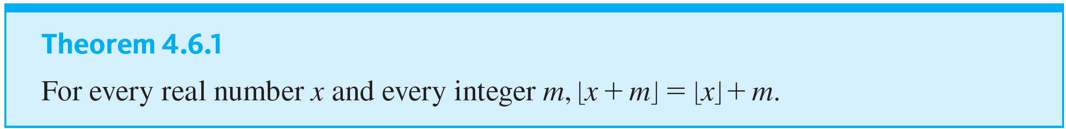
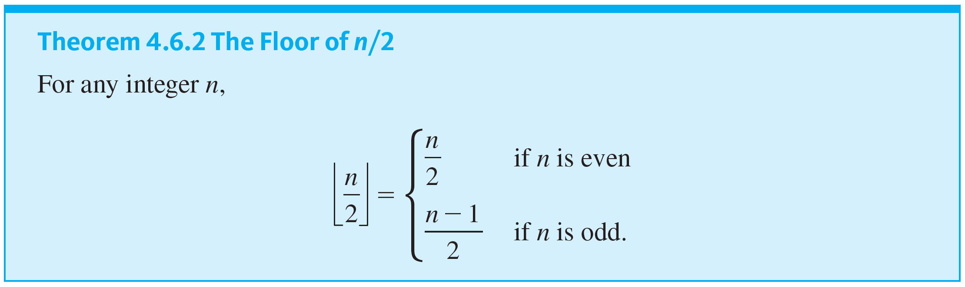
Direct Proof and Counterexample Ⅵ: Floor and Ceiling
This discussion is summarized as follows:

Slide 19
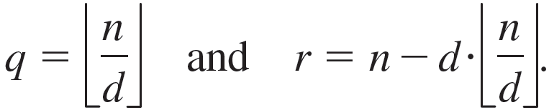
Direct Proof and Counterexample Ⅵ: Floor and Ceiling
Given any integer n and any positive integer d, the quotient-remainder theorem guarantees the existence of unique integers q and r such that
n = dq + r and 0 ≤ r < d.
The following theorem states that the floor notation can be used to describe q and r as follows:

Slide 20
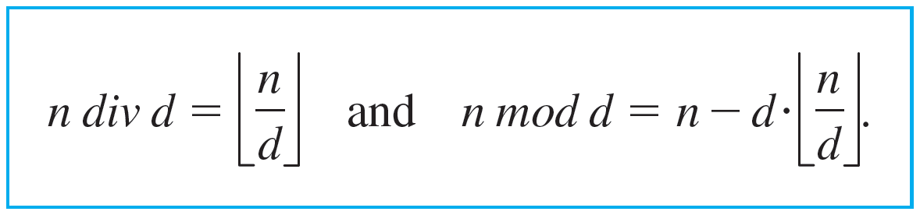
Direct Proof and Counterexample Ⅵ: Floor and Ceiling
Thus if, on a calculator or in a computer language, floor is built in but div and mod are not, div and mod can be defined as follows: For a nonnegative integer n and a positive integer d,
4.6.1
Note that d divides n if, and only if, n mod d = 0. In floor notation this means that d divides n if, and only if,
n = d · ⌊n ∕ d⌋.

Slide 21
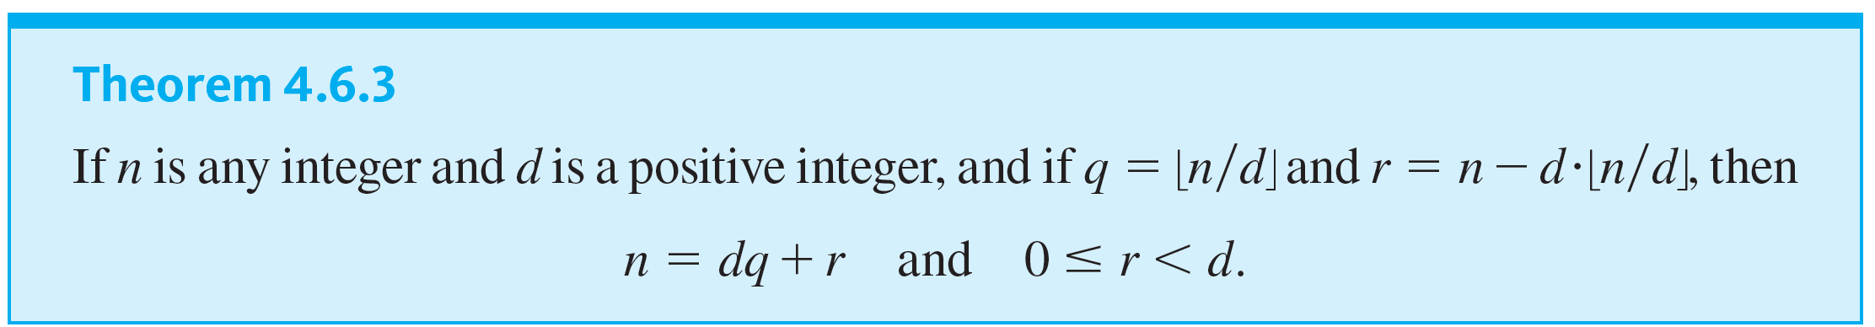
Direct Proof and Counterexample Ⅵ: Floor and Ceiling

Slide 22
Example 4.6.6 – Computing div and mod
Use the floor notation to compute 3,850 div 17 and 3,850 mod 17.

Slide 23
Example 4.6.6 – Solution
By formula (4.6.1),
3,850 div 17 = ⌊3,850 ∕ 17⌋ = ⌊226.4705882 …⌋ = 226
3,850 mod 17 = 3,850 − 17 · ⌊3,850 ∕ 17⌋
= 3,850 − 17 · 226
= 3,850 − 3,842 = 8.

